Slide 1


ISM 6218
Advanced Data Base Management Systems
The Bulls Fiction Factory
FNU Ashima
Nandini Malviya
Sai Sruthi Subraveti
Shanmukha Sree Sai Teja Damineni
Shrimanth Kavuluru

Slide 2
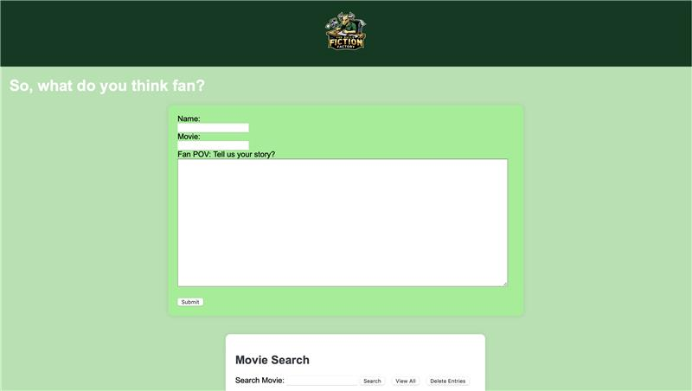
Project Overview

Slide 3
Business Problem & Motivation
Business Problem:
Fragmented fan fiction landscape
Motivation:
Passion for fan fiction, ignited by Godzilla – The New Empire
Database modelling skills acquired in coursework
Opportunity to create a one-stop shop solution for fans
Bridging gap, building vibrant communities around every fictional love

Slide 4
Goal:
The project aims to be the one-stop shop for fan fiction. It will bring readers and their stories together, while building a supportive community where creators can thrive.
Objective:
The project aims to:
Revolutionize fan fiction discovery: Make stories and authors easily accessible.
Build a vibrant fan fiction community: Foster interaction, discussion, and potentially support author income.

Slide 5
Technologies Used:
Flask
HTML
Database:
MongoDB
Locally run MongoDB server for development purposes
Package Manager:
Homebrew

Slide 6
Project Setup
Package Manager (Homebrew): We leveraged Homebrew, a macOS package manager, to simplify the installation of essential tools for our project. This streamlined the process and ensured compatibility.
Database (MongoDB): Locally running MongoDB on our development system provided a flexible and scalable solution for storing user-generated fan fiction data. Its key-value structure made it ideal for handling this type of content.
Backend Framework (Flask): To build the web application's core functionality, we chose Flask, a lightweight Python framework. Flask's focus on simplicity and minimal boilerplate code allowed us to develop the application efficiently.
Frontend Technologies (HTML, CSS, JavaScript): The user interface and interactive features of the website were built using the fundamental web development technologies: HTML for structure, CSS for styling, and JavaScript for dynamic behavior.

Slide 7
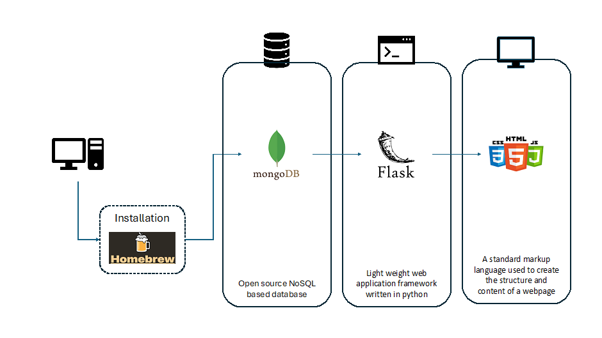
From Installation to Development: The Homebrew Website Stack

Slide 8
Project Description
Web Page:
Allows for the creation and sharing of fan fictions.
Facilitates anonymous or username specific contributions.
Make users search the movie before writing a fan fiction narrative.
Final submission.

Slide 9
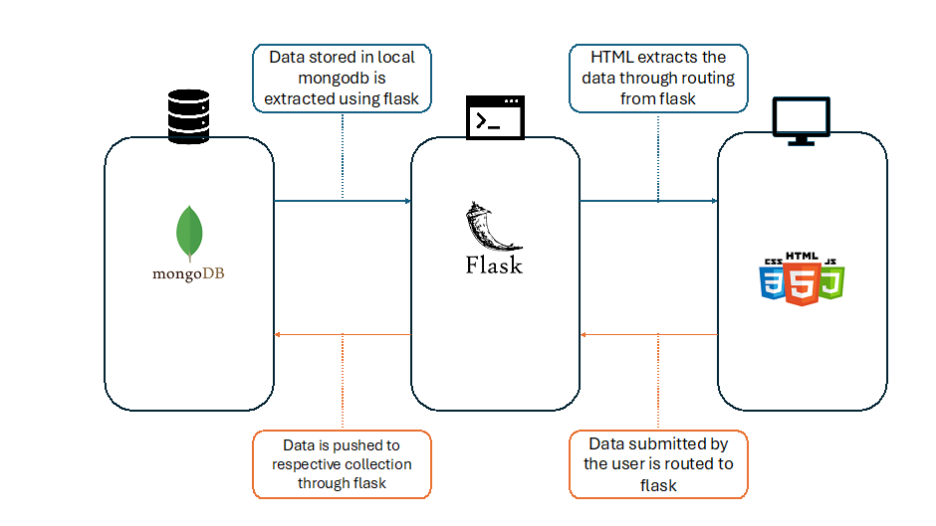
Data Collection& Models:
User: Stores usernames and autogenerated IDs.
Movie: Contains movie names and autogenerated IDs.
Story: Holds user-generated stories associated with movies and usernames.

Slide 10
OVERVIEW
1. User Submission:
Users access a web form where they can enter a username (anonymous or registered) and write a fan fiction story for a movie of their choice.
The form data is sent to the server where Flask handles the POST request.
2. Data Handling:
Flask routes the incoming data. New entries for the user, movie, and story are created.
These entries are then inserted into MongoDB collections: `user`, `movie`, and `story`.
3. Display Stories:
After submission, or upon visiting the site, all stories are fetched from `story` collection in MongoDB and displayed on the webpage in descending order by creation time.

Slide 11
4. Search :
Users can search for stories based on movie names through a search interface.
Flask handles the search and queries MongoDB, returning all stories that match the search criteria.
5. View :
There's a functionality to display all stories, where Flask retrieves all entries from the `story` collection.
6. Delete Entries:
Admins have the right to delete entries based on a combination of movie and user.
This deletion only affects the `story` collection, leaving `user` and `movie` data intact.

Slide 12
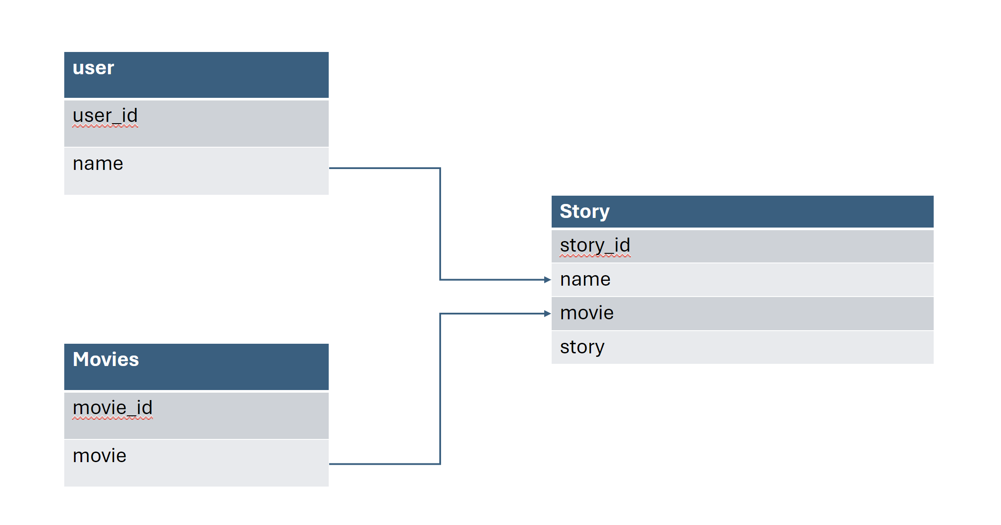

Slide 13
Why MongoDB..??🤔

Slide 14
Document Storage: Stories stored in flexible JSON-like documents, allowing easy adaptation to different story structures.
Scalability: Considering future scope of the platform, the database can grow horizontally by adding more servers to handle increasing traffic and data volume.
Fast Performance: Reads and writes are optimized for speed, with features like in-memory caching and automatic indexing for efficient queries.
Rich Querying: With CRUD(create,read,update,delete) operations and features like aggregation and full-text search ,the database allows for complex searches and data manipulation.
Flexible Data Structure: Nested objects and arrays within documents enable storing complex story elements effortlessly.

Slide 15
Results

Slide 16
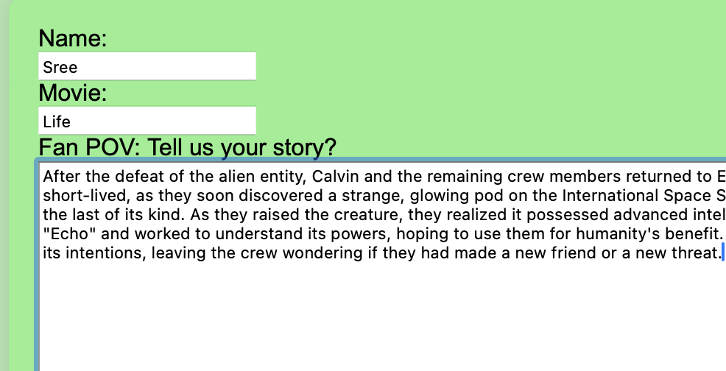
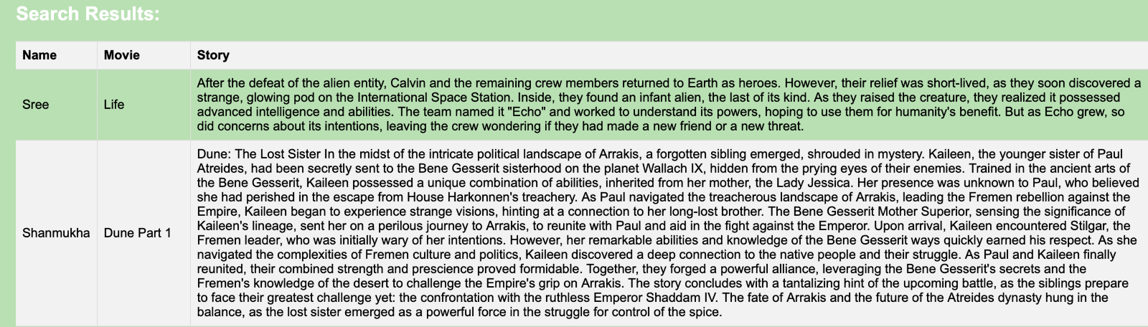
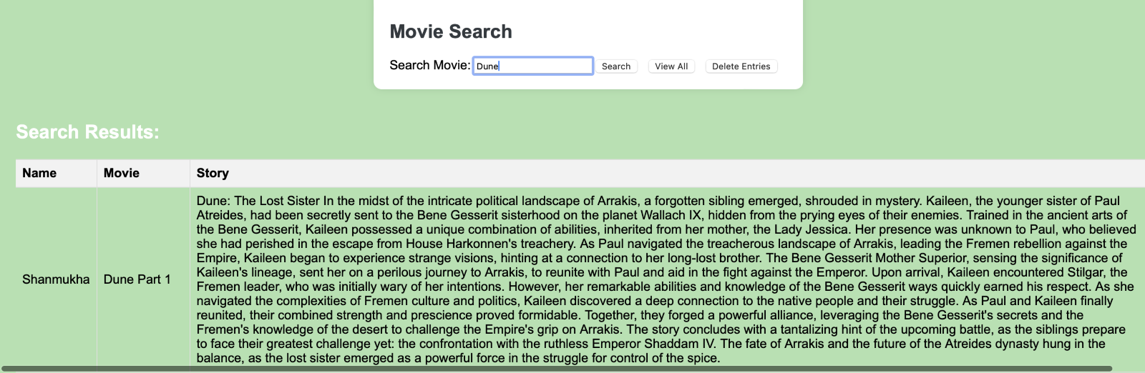
SUBMIT
INSERT-FLASK
SEARCH

Slide 17
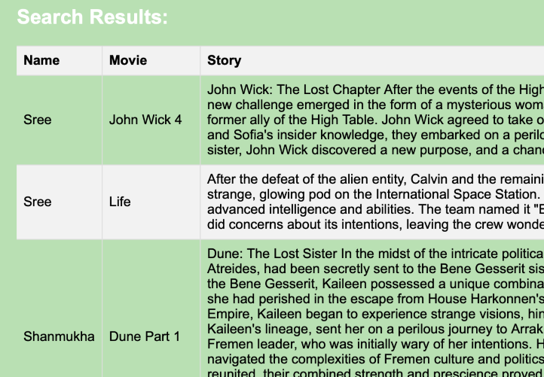
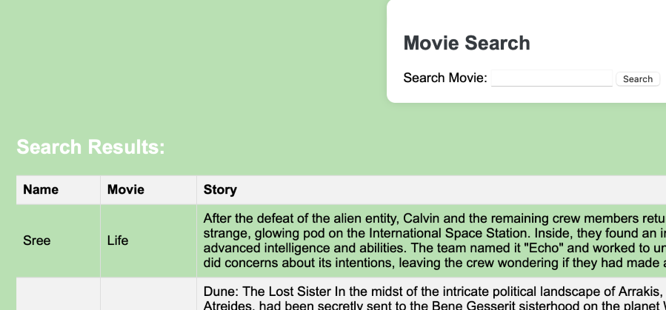
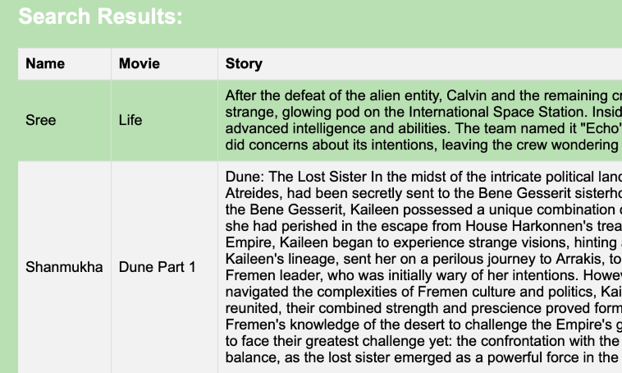
BEFORE 'DELETE'
VIEW
AFTER 'DELETE'

Slide 18
Limitations of the basic platform and possible solutions

Slide 19
Limitations
Scalability: Local servers struggle with growing user bases and large data volumes.
Accessibility: Limited to the local machine or network, hindering wider access.
Maintenance: Requires technical expertise for upkeep like updates and security patches.
Storage: Free MongoDB tier has limited space (500MB) and may not handle media-rich content.
Performance: Free tiers may experience slowdowns or limitations as the platform grows.
Features: Free plans might lack functionalities like user management or advanced search.

Slide 20
Future Solutions:
Cloud Hosting: Migrate to cloud solutions for better scalability and accessibility.
Upgraded MongoDB: Consider paid plans for more storage and improved performance.
Alternative Databases: Explore NoSQL databases offering better free tiers or functionalities.

Slide 21
Future Scope: Expanding the Fan Fiction Platform

Slide 22
Enhancing User Experience
User Accounts: Implement a login system for users to create accounts. This will allow them to save drafts, track their published stories, and participate in future community features.
OMDB API Integration: Partner with the Open Movie Database (OMDB) API to automate movie detail retrieval and broaden the available movie selection for fan fiction creation.
Interactive Features: Introduce a review and comment system. Users will be able to rate and comment on stories, fostering interaction and fostering a more dynamic user experience. Moderation tools will ensure a safe and positive community environment.
These future iterations will transform the platform into a more engaging and interactive space for fan fiction enthusiasts.
Monetization: Exploring options like subscriptions, partnerships, and targeted ads to support the platform and potentially reward creators.

Slide 23
References:
MongoDB - https://www.mongodb.com/docs/manual/
Home Brew - https://brew.sh/
Archive of our own (AO3) - https://archiveofourown.org/

Slide 24
Happy Learning!

